Slide 1
MOI UNIVERSITY
FORGING COLLABORATIONS TO MITIGATE DIGITAL ARCHIVING RISKS IN SELECTED UNIVERSITIES IN KENYA
J. Erima & F. Garaba
Notes:
<number>

Slide 2
Presentation outline
The context
Problem statement
Objective & research questions
Methodology
Literature review
Study findings
Conclusion
Recommendations

Slide 3
The context
Global technological advancements have transformed IM, RK.
Resulted in a paradigm shift in the archival sector from traditional AM to d-archiving (DA).
Notably, the state of DA in Africa, universities raises concern.
Archival repositories are constantly dealing with internal and external risks.
This paper advocates for collaboration among public universities with a view to harnessing resources towards joint ventures.

Slide 4
Overall objective and Research Questions
Objective
To investigate digital archiving (DA) practices in archival repositories of selected public universities in Kenya in order to develop a framework for sustainable maintenance of digital archives in the institutions.
Research questions
RQ1. How are digital archives identified and administered in Kenyan public universities?
RQ2. Which risk factors are digital archives exposed to in these universities?
RQ3. What possible solutions can be adopted to mitigate the identified risks and support sustainable digital archiving implementations in Kenyan public universities?

Slide 5
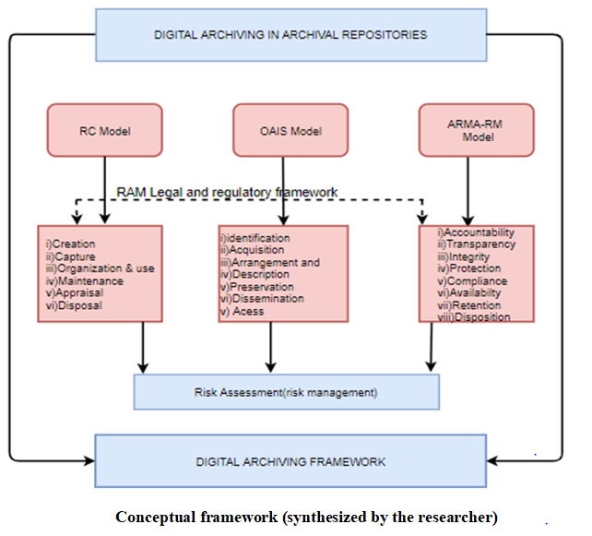

Slide 6
Literature review themes
The digital archiving concept;
Factors that determine the successful implementation of digital archiving initiatives;
Risk factors that inhibit the successful implementation of digital archiving initiatives;
Building a case for digital archiving collaboration and partnerships.

Slide 7
Research methodology
MMR
Six oldest p/universities- UoN, MU, KU, MU, JKUAT and EU.
Target population - 451
Sample of 205 selected (Krejcie & Morgan’s formular).
Respondents - DVCs, Finance Officers, Legal Officers, ICT Directors, Archivists, RMs, ICT staff and Administrators.
DC tools – S/questionnaires, semi-structured interviews & documentary review.
D/analysis - NVIVO, SPSS.

Slide 8
Study findings
*Discussed under sub-themes aligned to RQs.
Identification & administration of DAs
Large volumes of d-records created and captured during: teaching, research extension & outreach.
Records generated - course outlines, syllabus, course descriptions, quality assurance records, audit reports, theses, dissertations, etc.
Types & formats - emails, dbases, word processed documents, AVs, websites & d-publications, etc.
Archivists & RMs had no control over the formats.

Slide 9
Only university 2 univs had archival repositories.
The 2 univs had acquisition policies;
None had any formal guidance for appraisal.
Arrangement & description – No logical org’ of d-records in all.
Storage locations: creators’ comps; KENET cloud; external storage devices.
None had a preservation programme, policy or formal guidelines for d-records.
All engaged in: cloud computing; bit preservation, migration, refreshing, emulation, data backup & locally developed d-preservation solutions (5%).

Slide 10
No access policies in 5 univs; access via email tech; online access; printing & distribution of copies; downloading to comps.
Security measures: physical controls; passwords; tracking & data verification; regular performance audits; std procedures for reporting systems failure, etc.
Metadata capture was an on-going activity in all univs (involuntary).
Included: record identifier (ID); title/name; date of creation; business purpose/process/activity, and; creating software application.

Slide 11
Risk exposures for d-archives
RMPs; Organisation-wide risk assessment exercises.
Highly vulnerable at active & semi-active stages.
Risk sources for DAs:
Mgt of paper records alongside d-records;
Absence of DRM strategies;
Hardware and software obsolescence,
Virus attacks;
Unauthorized access,
Rapid technological advancements,
Environmental hazards,
File naming defects,
Rodents,
Accidental/malicious deletion and modification,
Data loss during transfer and;
Manmade disasters.

Slide 12
Conclusion
Routine practices in DAM were hampered by inadequacies during the mgt of d-records and long-term preservation of d-archives, because processes were not formalized.
Recommendations:
Collaboration and partnership ventures in DAM should be embraced by Kenyan public universities through the following strategies and framework:
1. Public universities in Kenya should create enabling environments for identifying and administering d-records throughout their LC – ICT Directors.

Slide 13
KNADS staff should play an advisory role by providing oversight to records, archives & ICT personnel – Joint sessions.
Archivists and records managers should carry out awareness & sensitization programmes at least once every financial year, to educate and inform staff about DRM and DA processes in universities – Inter-university workshops.
An overall risk management committee comprising of archivists, records managers and ICT Directors should be formed to re-examine and review risk management policies and ensure DA aspects are clearly entrenched to minimise risk exposures.

Slide 14
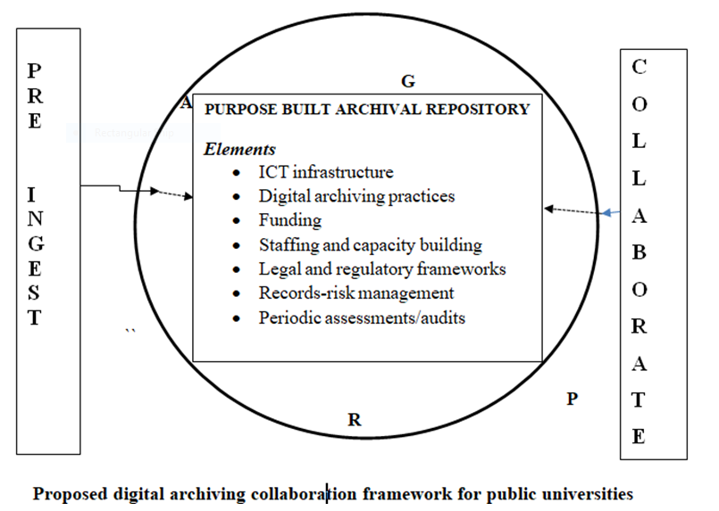
Notes:
<number>

Slide 15
Sources
Erima, J. 2022. A framework for digital archiving at selected public universities in Kenya. PhD Thesis [Doctor of Philosophy]. Pietermaritzburg: University of KwaZulu-Natal. School of Sociology and Social Studies. Information Studies programme. Available:
https://ukzn-dspace.ukzn.ac.za/bitstream/handle/10413/20792/Erima_Juliet_Awinja_2022.pdf?sequence=1&isAllowed=y
Erima, J. and Garaba F. 2022. Mixing of research methods in investigating digital archiving practices at selected public universities in Kenya. In: Ngulube, P. (ed.). Mixed methods research in information Sciences. Hershey, PA: IGI Global. pp. 531-557.
Notes:
<number>

Slide 16


