Slide 1
Digital Research Environment (DRE): Cluster Wide Model
MR. SOLOMON MUTAI
skmutai@mu.ac.ke

Slide 2
OVERVIEW
Why Manage Research data?
Africamultiple Cluster of Excellence & DRE
Current situation
Why Dspace
Future plans

Slide 3
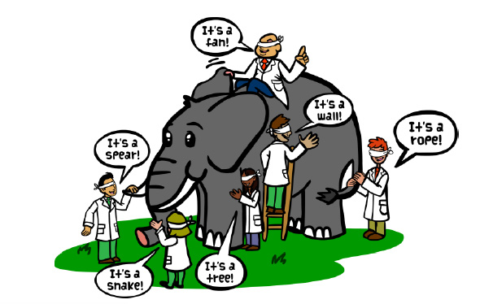
The Parable

Slide 4
RESEARCH DATA IN ACCs
AIM: Input and search data within ACCs
Browse through data across disciplines to enrich research direction with new insights and to address related research questions
Collaborative research in African studies
  connecting a wide range of academic disciplines;
  building an innovative digital research environment;

Slide 5
What Data?
Video and voice recordings
Questionnaires and interview transcripts
Test results held in text files and spreadsheets
Archive materials and handwritten notes
Code and software
Photographs and slides
Laboratory notebooks

Slide 6
Why Manage Research Data?
Efficiency and ease of data control, with reduced risk of data loss
Greater visibility of data, leading to increased citations and future collaborations
Demostration of research integrity and validation of research results
Compliance with funder and institutional policies and expectations
Greater impact of research through knowledge transfer
Research advances through reuse of data by researchers within the clusters / world

Slide 7
Data Sharing and Management

Slide 8
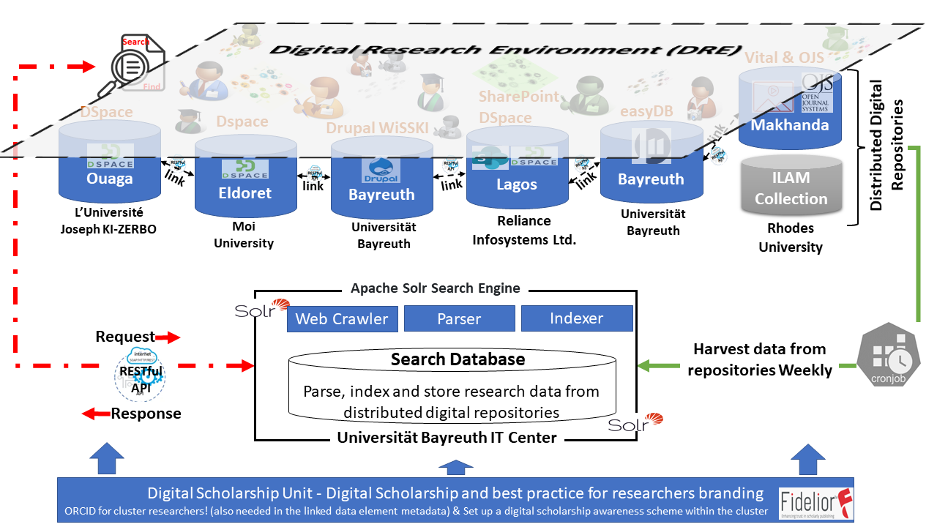
Current DRE Project

Slide 9
Why DSPace?
Can handle
  Pre-prints, articles
  Postprints
  Technical reports
  Conference papers / presentations
  Theses/Dissertations
  Datasets e.g statistics, geospatial, scientific

Slide 10
Why DSPace?
Standards
  Dublin Core
  OAI-PMH (Open Archives Initiative Protocol for Metadata Harvesting)
  UNICODE
It has capabilities to support other standards such as: METS (Metadata Encoding and Transmission Standard) and MODS (Metadata Object Description Schema)

Slide 11
Why DSPace?
Searchable and indexed by major search engines including Google Scholar.
Already registered in the Directory of Open Access Repositories (DOAR)
Link to ORCID (Open Research and Contributor ID)

Slide 12
Current Situation @ MU
Currenly using DSpace version 6.3 need to upgrade to 7.4
Implement the common Dspace 7.4 matadata schema
Migrate local data to Dspace community space
Need to constitute a new working group involving ACC PIs and Data Management / Repository staff
Review IR Policy to include Research Data

Slide 13
Current Situation @ MUACC
Conference / workshop presentations are uploaded as book of abstracts
Not searchable
Research data held by individual reseachers
See example

Slide 14
Challenges @ MU
Server space and capabilities
Need to build capacity on data management and Data curation (most are Information Scientists)
Data Information Knowledge

Slide 15
Bayreuth 2023 - 2025
Working on WissKi Data Model – current tsak
Map DSpace to WissKi – April 2023
Actual integration of metadada from projects – after we are all ready
Find projects to showcase interdisciplinary research possibilities

Slide 16
2025 – 2032 Strategy (Establish RDM Unit)
1a. Digital Scholarship (scholarly communication, scholarship research, digital artefacts, virtual library, born digital materials, scholarly commons)
1b. Digital Research Environment Readiness (Networking, collaboration, data and project management, digital literacy, digital repositories, digital media lab)
1c. Digital capacity building at all ACCs that enables both staff and researchers to attain certified skills in research data management (Under Institute of African Studies?)

Slide 17
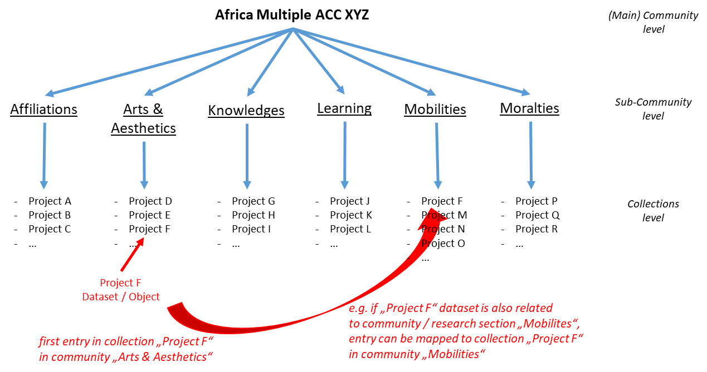
Possible structure - suggested

Slide 18
THE END
THANK YOU

