Slide 1

Original Article
Low-Dose Yellow Fever Vaccine in Adults in Africa
Derick Kimathi, Ph.D., Aitana Juan-Giner, M.Sc., Ndeye S. Bob, Ph.D., Benedict Orindi, Ph.D., Maria L. Namulwana, M.B., Ch.B., Antoine Diatta, Pharm.D., Stanley Cheruiyot, B.Sc., Gamou Fall, Ph.D., Moussa Dia, M.Sc., Mainga M. Hamaluba, M.D., Dan Nyehangane, M.Sc., Henry K. Karanja, M.Sc., John N. Gitonga, B.Sc., Daisy Mugo, B.Sc., Donwilliams O. Omuoyo, B.Sc., Mwatasa Hussein, M.Sc., Elizaphan Oloo, Dip., Naomi Kamau, B.Sc., Jackline Wafula, M.Sc., Josephine Bendera, K.C.S.E., Namanya Silvester, M.B., Ch.B., James Mwavita, K.C.S.E., Musiimenta Joshua, B.N.S., Jane Mwendwa, B.Sc., Collins Agababyona, M.A., Caroline Ngetsa, M.Sc., Nalusaji Aisha, B.M.L.S., Felix Moki, Dip., Titus Buluku, Dip., Marianne Munene, M.Sc., Juliet Mwanga-Amumpaire, Ph.D., Julius Lutwama, Ph.D., John Kayiwa, M.Sc., Eunice Kamaara, Ph.D., Alan D. Barrett, Ph.D., Pontiano Kaleebu, Ph.D., Philip Bejon, Ph.D., Amadou A. Sall, Ph.D., Rebecca F. Grais, Ph.D., George M. Warimwe, Ph.D., for the NIFTY Investigators
N Engl J Med
Volume 392(8):788-797
February 20, 2025

Slide 2
Study Overview
Although the yellow fever vaccine is highly effective, supply is limited.
In a trial in Africa, lower doses of vaccine were noninferior to a standard dose for producing seroconversion within 28 days.

Slide 3
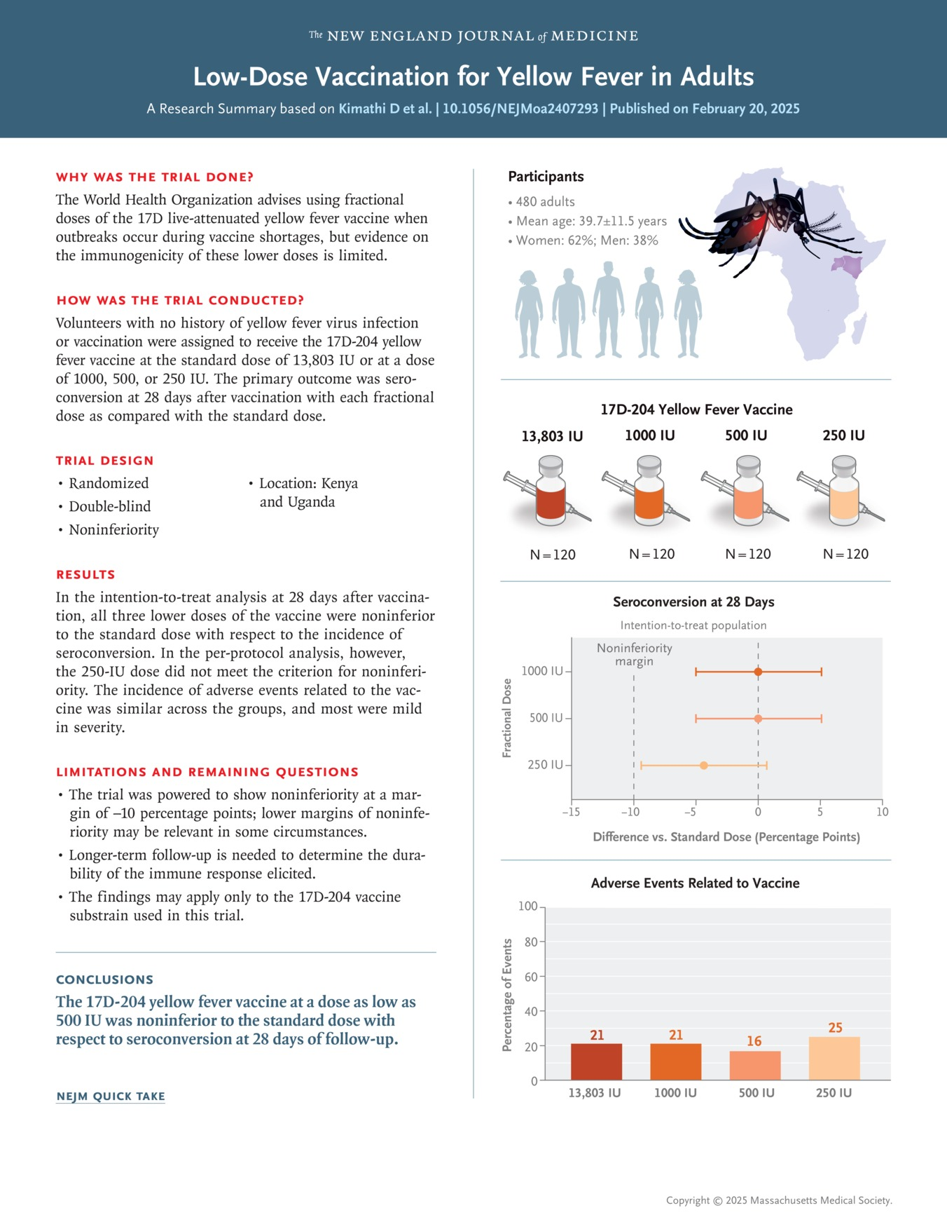
Kimathi D et al. N Engl J Med2025;392:788-797
Notes:
Download a PDF of the Research Summary.

Slide 4
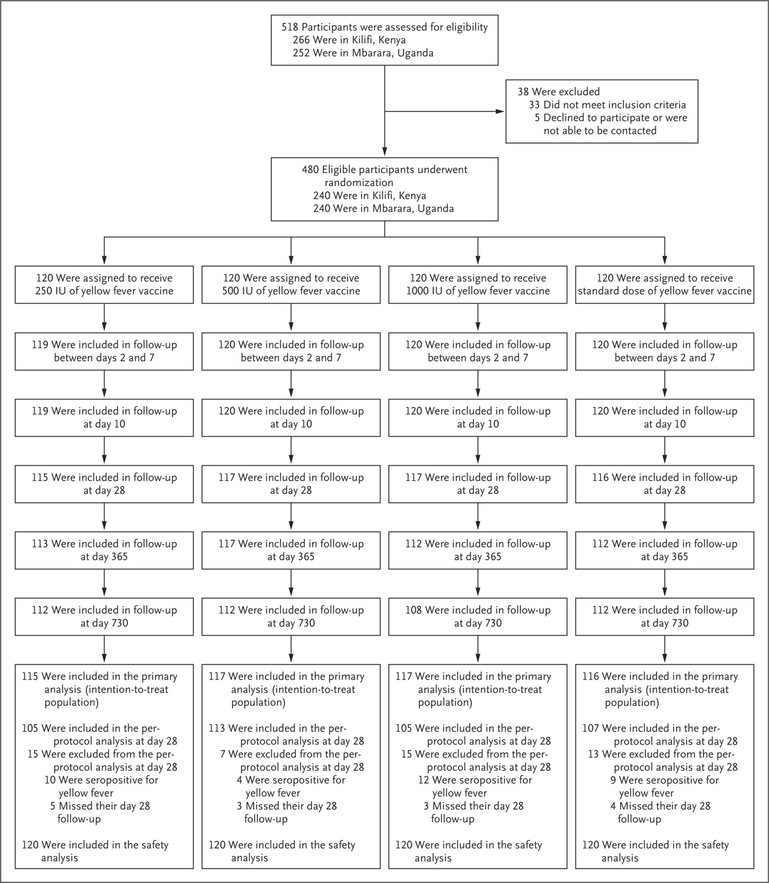
Screening, Enrollment, Randomization, Administration of Vaccine, and Follow-up.
Kimathi D et al. N Engl J Med2025;392:788-797
Notes:
Figure 1 Screening, Enrollment, Randomization, Administration of Vaccine, and Follow-up.

Slide 5
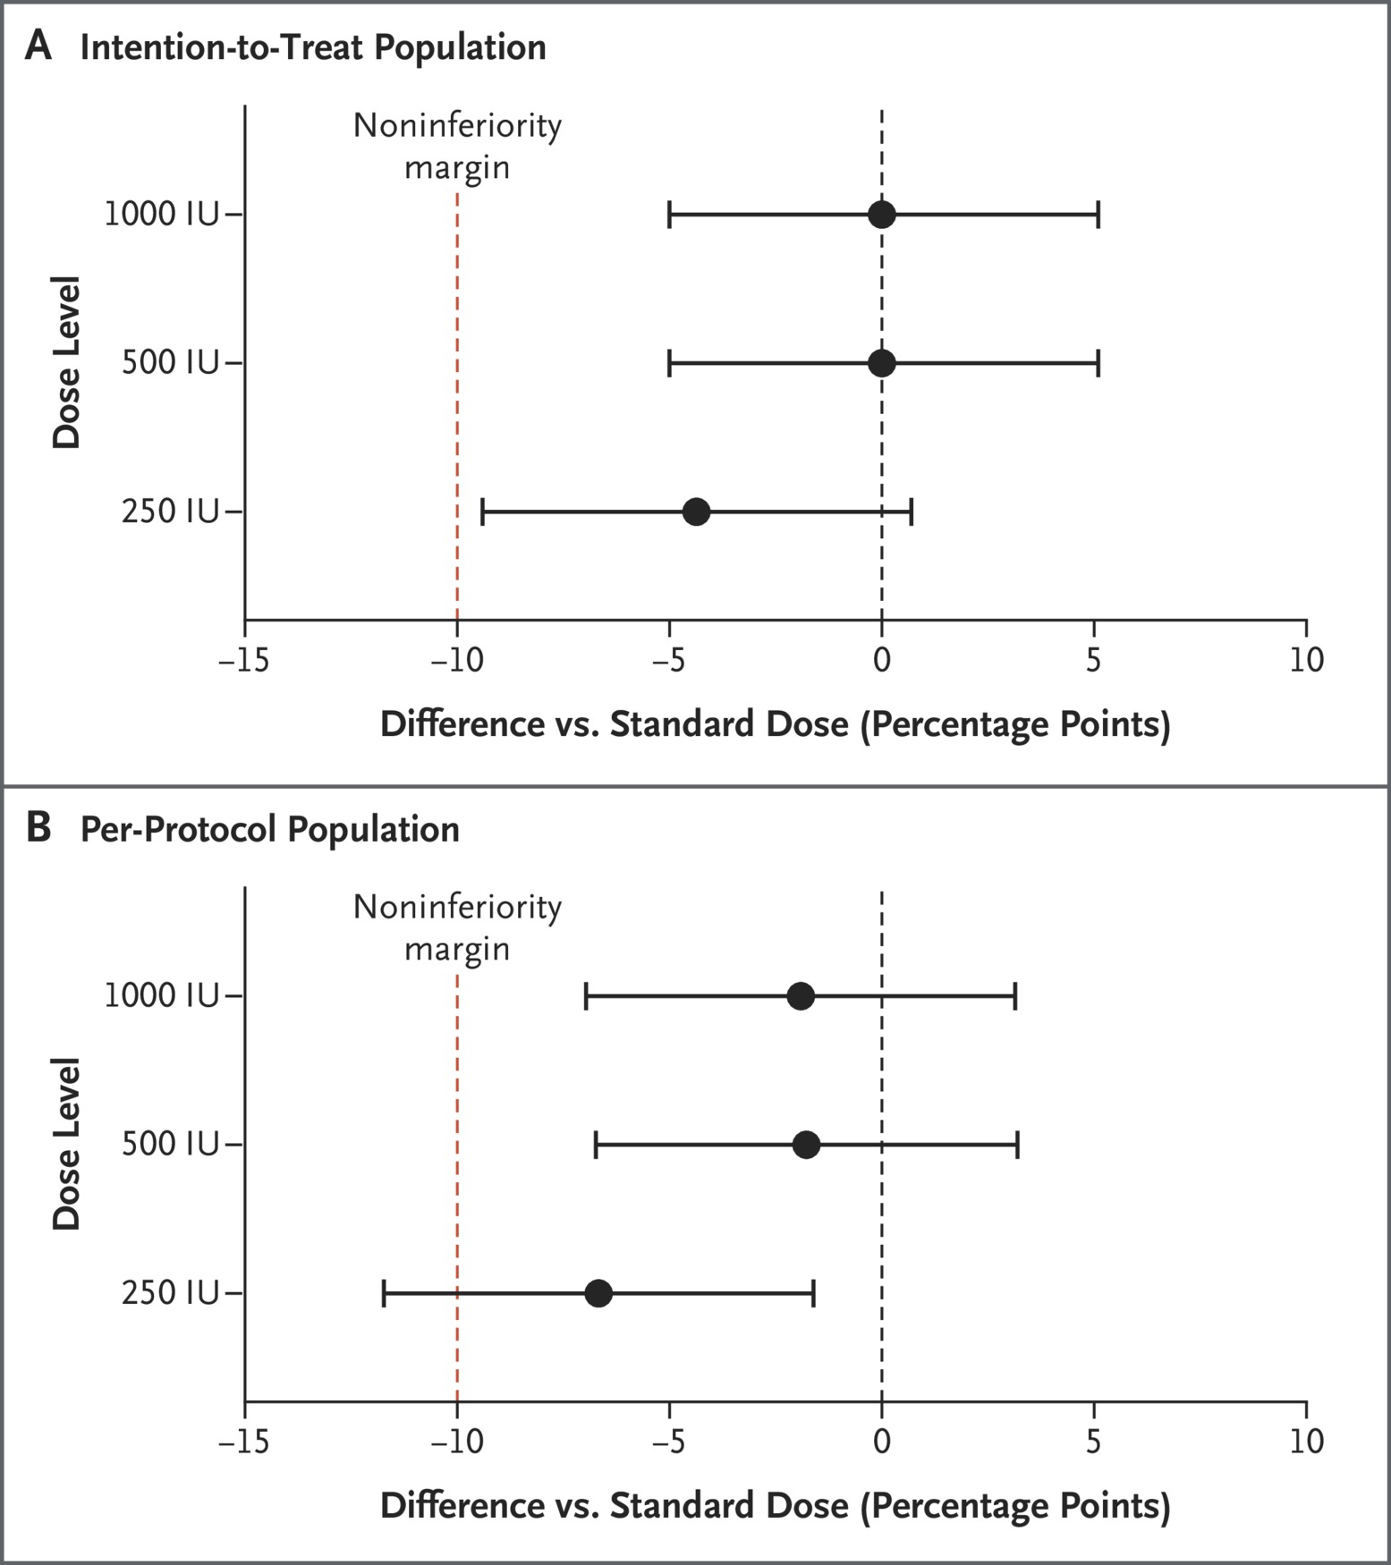
Seroconversion 28 Days after Vaccination with Fractional Doses of Yellow Fever Vaccine as Compared with Standard Dose.
Kimathi D et al. N Engl J Med2025;392:788-797
Notes:
Figure 2 Seroconversion 28 Days after Vaccination with Fractional Doses of Yellow Fever Vaccine as Compared with Standard Dose. Shown are the differences in the incidence of seroconversion with fractional doses of 250 IU, 500 IU, and 1000 IU, as compared with the standard dose (13,803 IU), in the intention-to-treat population (Panel A) and the per-protocol population (Panel B). Seroconversion was defined as an antibody titer on a 50% plaque reduction neutralization assay that was at least four times as high as prevaccination titers. Horizontal bars indicate 95% confidence intervals.

Slide 6
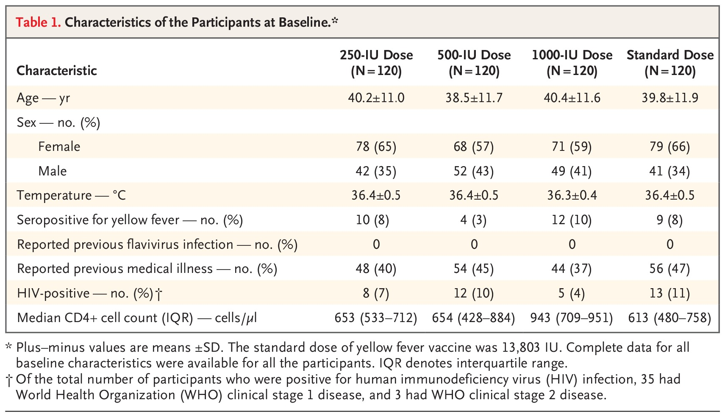
Characteristics of the Participants at Baseline.
Kimathi D et al. N Engl J Med2025;392:788-797
Notes:
Table 1 Characteristics of the Participants at Baseline.

Slide 7
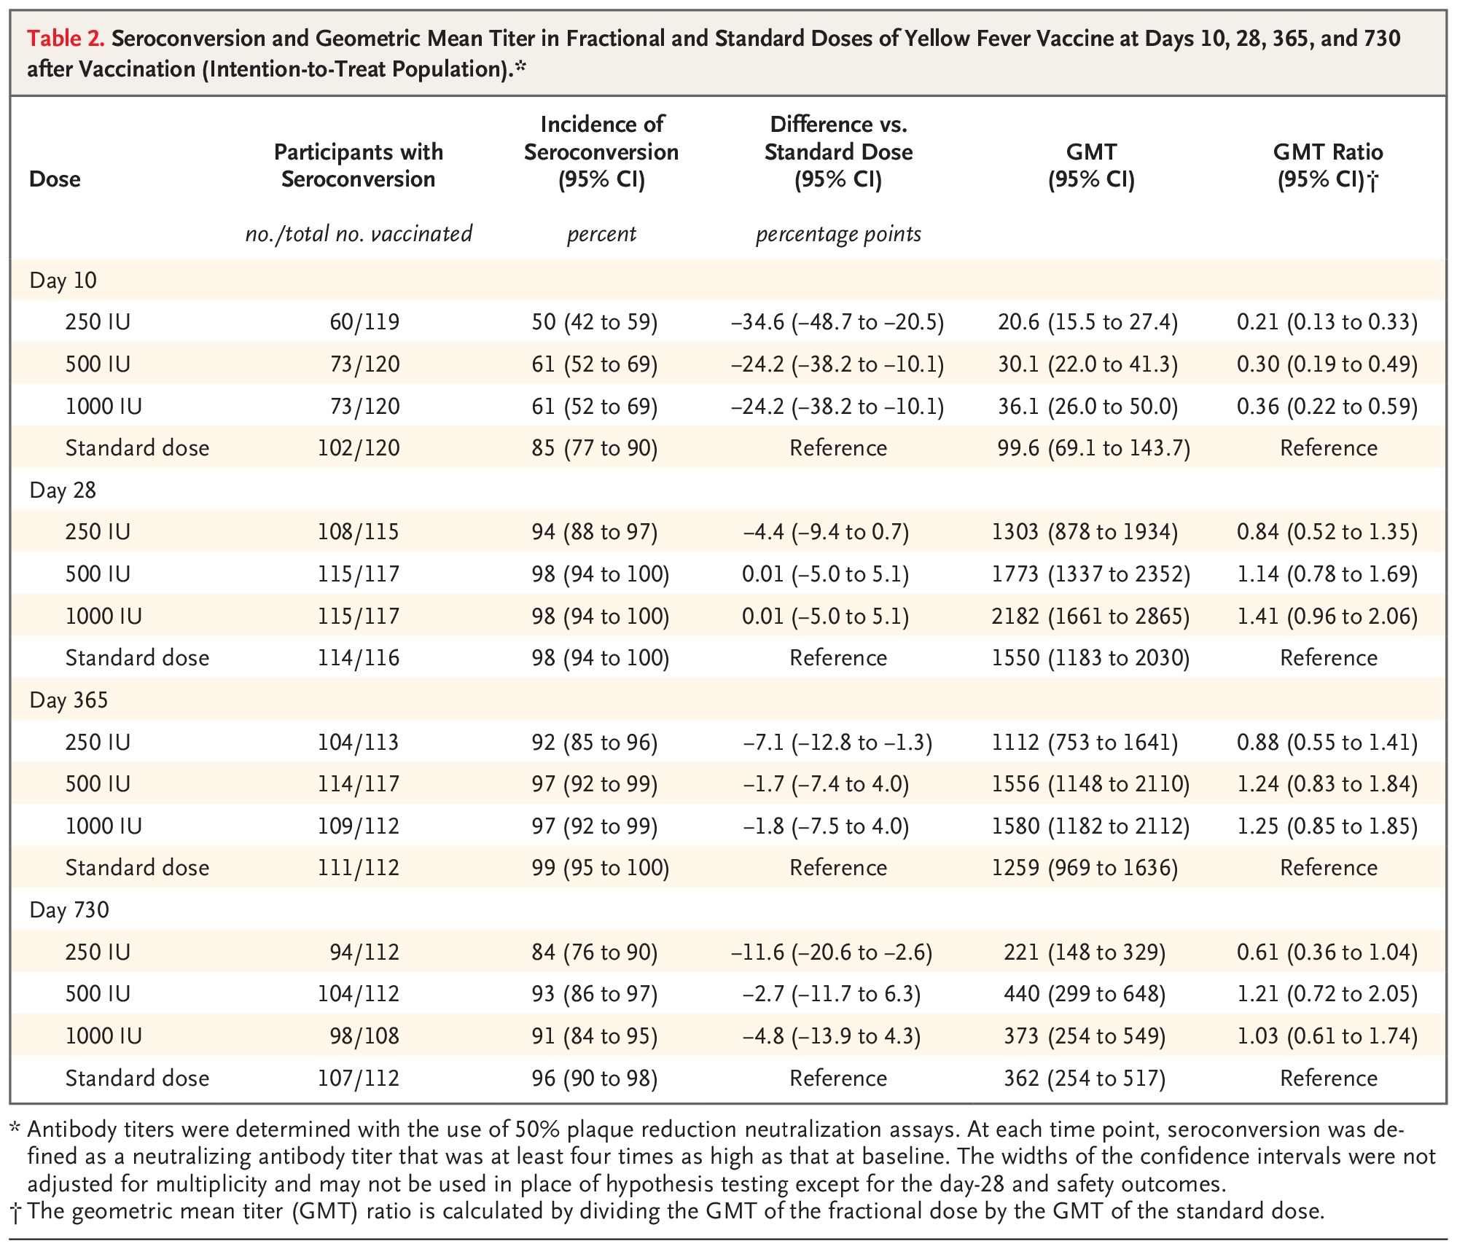
Seroconversion and Geometric Mean Titer in Fractional and Standard Doses of Yellow Fever Vaccine at Days 10, 28, 365, and 730 after Vaccination (Intention-to-Treat Population).
Kimathi D et al. N Engl J Med2025;392:788-797
Notes:
Table 2 Seroconversion and Geometric Mean Titer in Fractional and Standard Doses of Yellow Fever Vaccine at Days 10, 28, 365, and 730 after Vaccination (Intention-to-Treat Population).

Slide 8
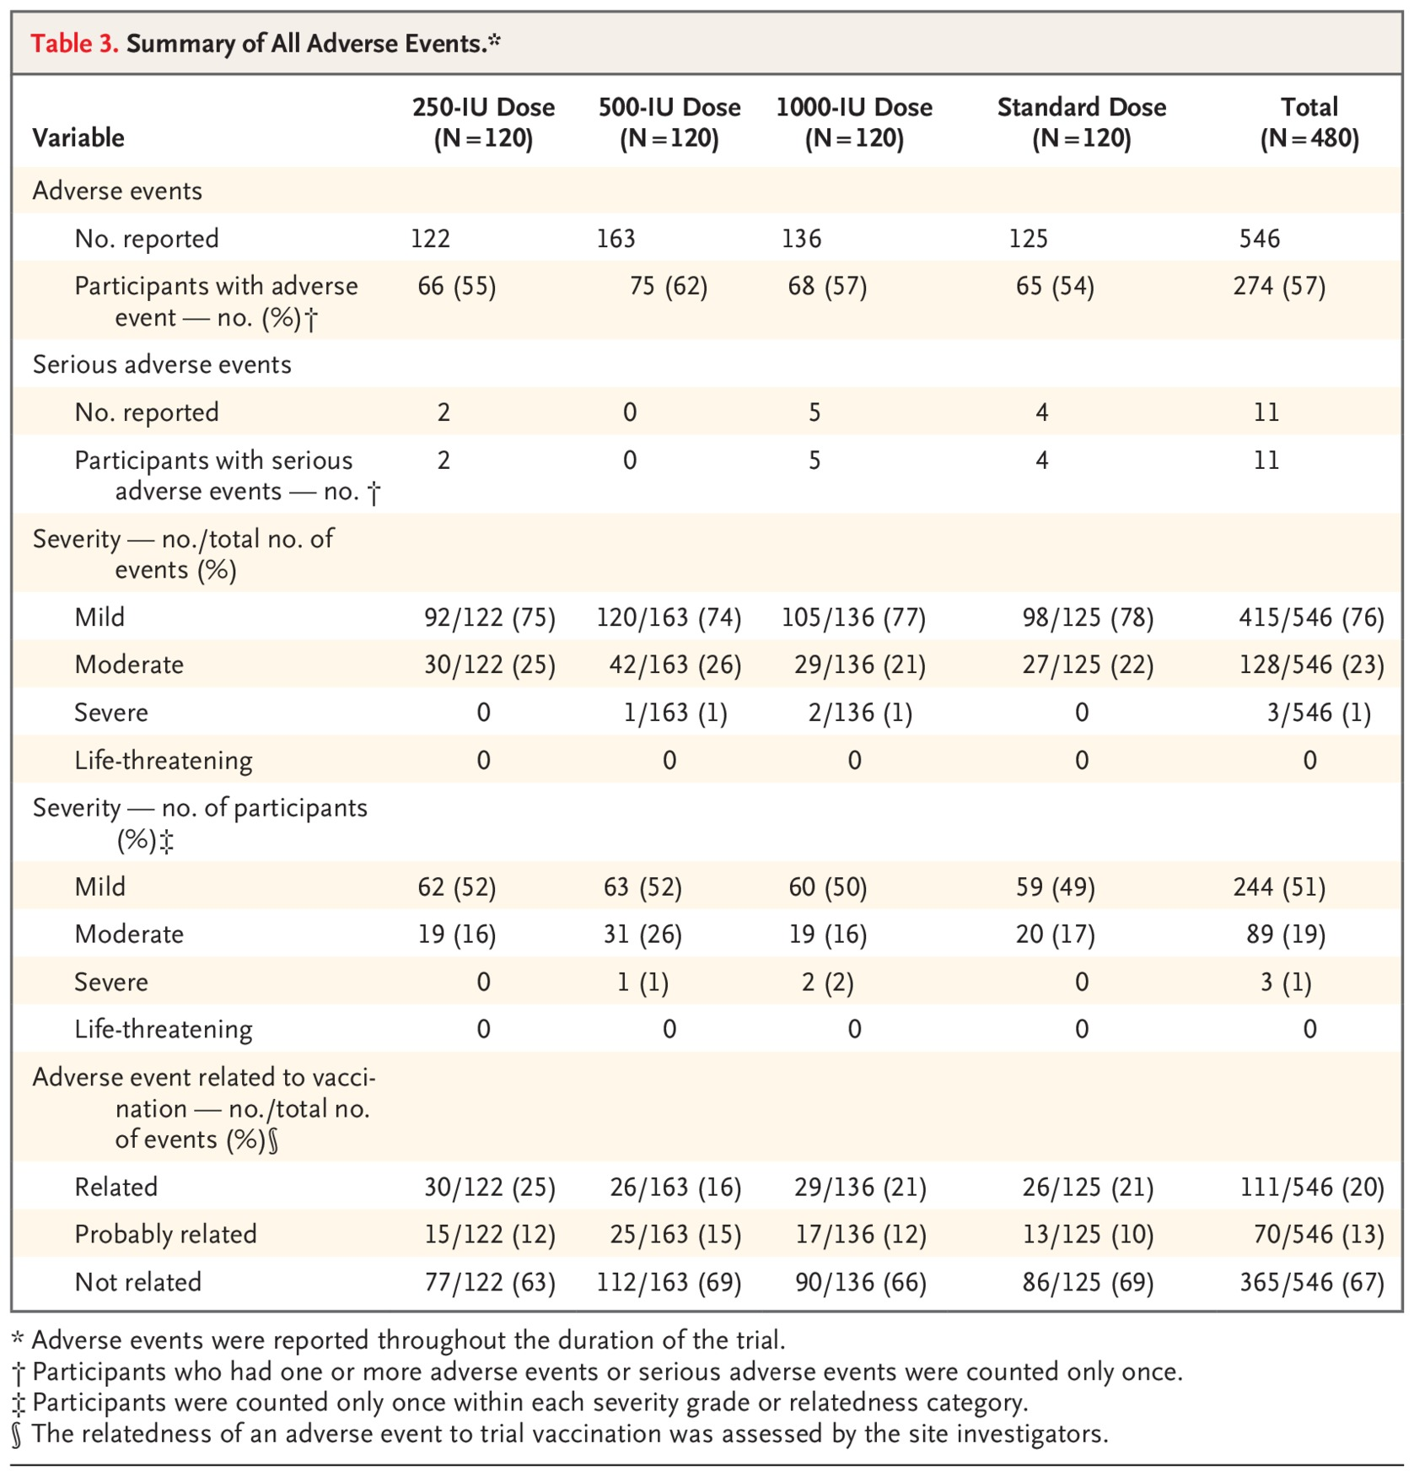
Summary of All Adverse Events.
Kimathi D et al. N Engl J Med2025;392:788-797
Notes:
Table 3 Summary of All Adverse Events.

Slide 9
Conclusions
A yellow fever vaccination dose as low as 500 IU was noninferior to the standard dose of 13,803 IU for producing seroconversion within 28 days.

